Slide 1
Hard Disk Scratch Identifier
By
Vishnuraja V

Slide 2
Content
Problem statement
Model Training
Histogram of Oriented Gradients
Support Vector Machine
Model Testing
Sliding Window
Pyramid Gaussian
Non-maximum suppression
OpenVINO
Intel Neural Compute Stick 2
Sample output

Slide 3
Problem statement
Identifying scratches & crack in Hard disk

Slide 4
Model Training
Histogram of Oriented Gradients(HOG)
Histogram of Oriented Gradients, also known as HOG, is a feature descriptor like the Canny Edge Detector, SIFT (Scale Invariant and Feature Transform) .
It is used in computer vision and image processing for the purpose of object detection.
The technique counts occurrences of gradient orientation in the localized portion of an image.
HOG is a simple and powerful feature descriptor. It is not only used for face detection but also it is widely used for object detection like cars, pets, and fruits.
HOG is robust for object detection because object shape is characterized using the local intensity gradient distribution and edge direction. Histogram of Oriented Gradients, is a feature descriptor that is often used to extract features from image data.
It is widely used in computer vision tasks for object detection.

Slide 5
Support Vector Machine(SVM)
Support vector machines (SVMs) are a set of supervised learning methods used for classification, regression and outliers detection. The advantages of support vector machines is Effective in high dimensional spaces.
This is an application of Object detection using Histogram of Oriented Gradients (HOG) as features and Support Vector Machines (SVM) as the classifier.

Slide 6
Model Testing
Sliding Window
Sliding window is a rectangular region of fixed width and height that “slides” across an image. We slide a window from left-to-right and top-to-bottom. They allow us to localize exactly “where” in an image an object resides
Pyramid Gaussian
We create a set of the same image with different resolutions and search for object in all of them. These set of images with different resolutions are called Image Pyramids. Utilizing both a sliding window and an image pyramid we are able to detect objects in images at various scales and locations.
Non-maximum suppression
Non max suppression is a technique used mainly in object detection that aims at selecting the best bounding box out of a set of overlapping boxes.

Slide 7
OpenVINO
OpenVINO - Open Visual Inference and Neural Network Optimization
It is a toolkit provided by Intel to facilitate faster inference of deep learning models. It helps developers to create cost-effective and robust computer vision applications.
Benefits of OpenVINO is Accelerate Performance
The OpenVINO toolkit covers both computer vision and non-computer vision workloads across Intel hardware.
It maximizes performance and accelerates application development.

Slide 8
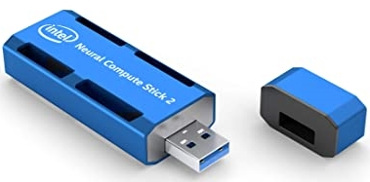
Intel Neural Compute Stick 2
Intel Neural Compute Stick 2 (NCS 2) is a development and prototyping platform. You can use it to quickly bring computer vision and AI to IoT and edge devices.
The Intel Neural Compute Stick 2 achieves a total performance of over 4 trillion operations-per-second. The enhanced vision accelerators make the Myriad X very useful to perform demanding computer vision tasks.

Slide 9
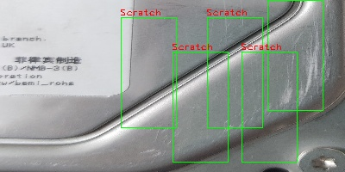
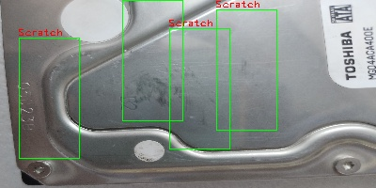
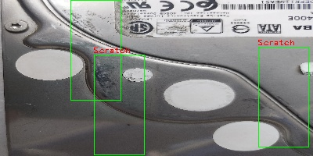
Sample output

Slide 10
Thank You

